Slide 1

Syndromic Surveillance (SS)
Validation Tool
Tutorial and Guide
Robert Snelick
National Institute of Standards and Technology
January 22, 2016
Contact: rsnelick@nist.gov

Slide 2
http://hl7v2-ss-r2-testing.nist.gov/
Syndromic Surveillance Validation Tool Overview
Purpose: The tool validates Syndromic Surveillance (SS) messages created by Health IT Modules, and Context-based Testing is intended for ONC 2015 Edition certification.
Tool Key Capabilities
Context-free Testing | (No Test Scenario - Test any Syndromic Surveillance message created by EHR) Context is unknown to validation tool Provides a simple and convenient method for testing message structure and most vocabulary
Context-based Testing | (Test Scenarios - Test Syndromic Surveillance message associated with a specific test scenario) Context is known to validation tool All conformance requirements of the SS Implementation Guide can be assessed Used for certifying ONC 2015 Edition Health IT Modules
Profile Viewer | Provides a browsable version of the conformance profile which encapsulates the requirements. Can be used to assist in the interpretation of errors.
Value Set Browser | Provides a browsable view of the vocabulary requirements. Can be used to assist in the interpretation of value set errors.
Documentation | Provides access to documents that will assist in using the tool (including test procedure, test cases, profile descriptions, vocabulary descriptions and validation tool download).
No registration or log-in credentials are needed. Simply click on the link below and send/paste/load message into tool to obtain a Validation report.
NOTE: The Test Tool (.war file) can also be downloaded and installed locally.
NOTE: Web Application is compatible with Firefox, Chrome, and Safari.
Register to Google Group at: https://groups.google.com/d/forum/hl7v2-syndromic-testing to ask questions and provide feedback.

Slide 3
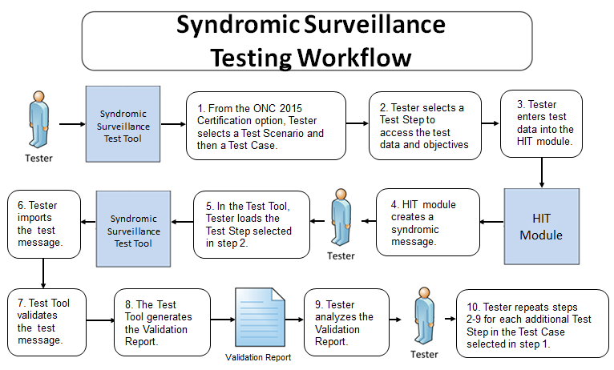
Syndromic Testing Process

Slide 4
Syndromic Surveillance Context-free
Test Scenario Walk Through Tool Demonstration

Slide 5
Syndromic Context-free Testing Work Flow (Step by Step)
1) Import test message
Open Syndromic Surveillance Validation tool using link: http://hl7v2-ss-r2-testing.nist.gov/ Click on Context-free Validation tab. Select a conformance profile to use to validate the message. Click on Browse Message button to load message into Message Content window. Message Uploader Dialog window displays. Click on Select Message button. Open test message file to upload it.
2) Validate test message and review message validation errors
Uploaded test message displays. If message fails validation, errors will display in Message Validation Result section of page. Click on location link to highlight the data element causing the error within the Message Tree and Content. Description explains why error occurred. Format or table of data element may be provided. Line number and column of errors are provided. Location link displays the location of the data element. Click on page numbers to view additional pages of errors.
3) Look up valid data element values and tables
Click on Profile Viewer tab. Click on a tab to select the conformance profile. Select R, RE, C (Only) to view only required, required but may be empty and conditional elements. Select R, RE, C, O, X (All) to view all data elements, including optional and not supported elements. Click on a tab to filter data elements by segment. Locate data element using element name from the location link. Make a note of the Value Set. Click on Vocabulary tab. Locate and select table ID. Valid values are listed. Click on Context-free Validation tab to return to message.

Slide 6
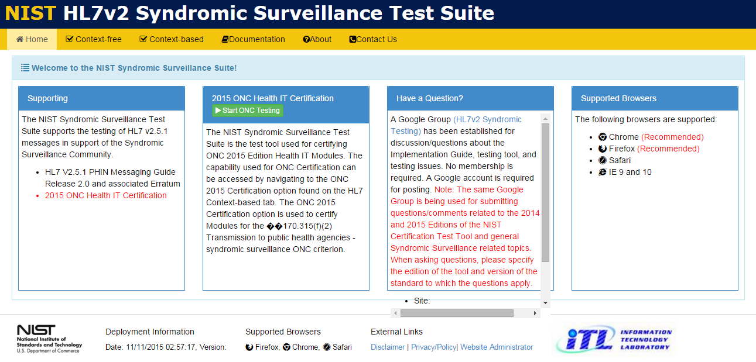
Tool Access and Navigation
Objectives | Informative Reference
Establish access to the NIST Syndromic Surveillance Test tool (web application). Locate the Navigation Bar. Locate the SS Home page. Locate the Test Suite. | The NIST SS Test Tool is accessible through the following URL: http://hl7v2-ss-r2-testing.nist.gov/. This displays the NIST Syndromic Surveillance Test Suite’s Welcome Screen, which is indicated by the ‘Home’ tab. The ‘Documentation’ tab contains relevant downloadable User, Documentation, Resources/Artifacts, and Notations.
2
Open Syndromic Surveillance Validation tool using link: http://hl7v2-ss-r2-testing.nist.gov/
2
The tool’s Navigation Bar is located along the top. The options are ‘Home’, ‘Context free’, ‘Context-based’, ‘Documentation’, ‘About’ and ‘Contact Us’..
The Welcome Screen is located under the ‘Home’ tab.
The Welcome Screen provides information about Supporting the Syndromic Surveillance community, information about 2015 ONC Health IT Certification, questions on the tool and supported browsers.,

Slide 7

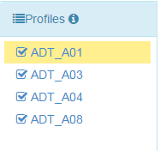
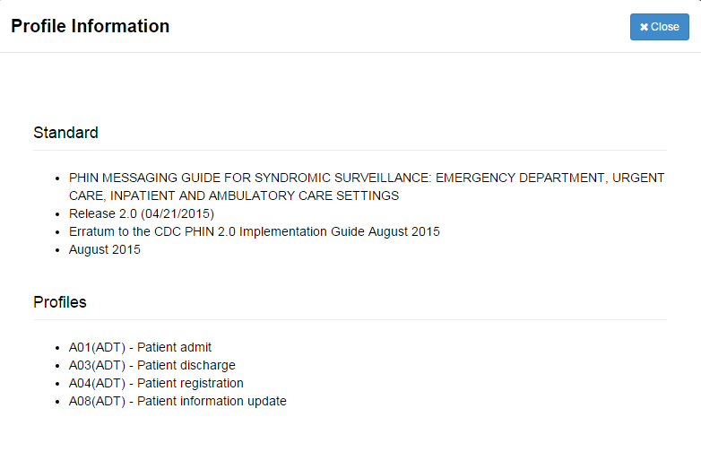
Conformance Profile Selection
Objectives | Informative Reference
Locate the ‘HL7 Context-free’ tab on the Navigation Bar. Locate the NIST SS Test Tool’s available ‘Conformance Profiles’. | This page provides a selection of Conformance Profiles to choose from. Information about the different profiles are provided by clicking on the information icon.
3
Select ‘HL7 Context-free’ from the
Navigation Bar.
4
Select a ‘Conformance Profile’ to test an HL7 message against.
5
Selecting the ‘i’ information button expands a detailed reference compendium for the Conformance Profiles.
Refer to CDC HL7 Version 2.5.1 Implementation Guide for Immunization Messaging (current release) for further detailed information
6
Select the ‘Validation’ tab.
Notes:
Images associated with 2, 3, and 4 too small to read

Slide 8
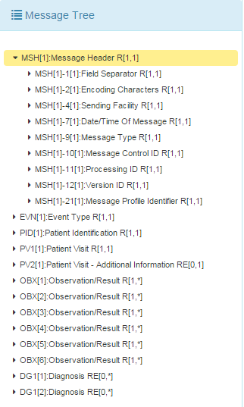
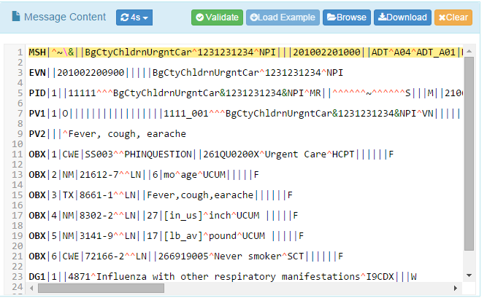
Load HL7 Message
Objectives | Informative Reference
Locate the ‘Context-free’ tab on the Navigation Bar. Locate and select a profile from the NIST SS Test Tool’s available ‘Conformance Profiles’. Load an HL7 message into the NIST SS Test Tool (either from local storage or by example). | This page validates any Syndromic message. Testing will include the technical requirements and content-specific requirements specified in the selected profile.
7
With a Conformance Profile selected, an HL7 message can be loaded into the ‘Message Content’ field by:
Clicking the ‘Browse’ button to load an existing HL7 message from the Tester’s local machine; or
Clicking the ‘Load Example’ button to populate sample HL7 message.
Clicking the ‘Validation’ button performs message validation against the selected Conformance Profile. The validation frequency can be manipulated from ‘1 to 8 seconds’.
Selecting ‘Download’ allows you to save the HL7 message in a .TXT formatted file on the Tester’s local machine.
Selecting ‘Clear’ clears all HL7 related message data from the Message Content field.
8
When an HL7 message is loaded into the Message Content field, the ‘Message Tree’ is automatically populated with the relevant HL7 message instance segments. Clicking the arrows to expand and contract the segments. Selecting an individual item shows its exact path with the Message Content field and viewable HL7 message (highlighted in yellow).
Notes:
Images with 5, 6, and 7 too small to read

Slide 9
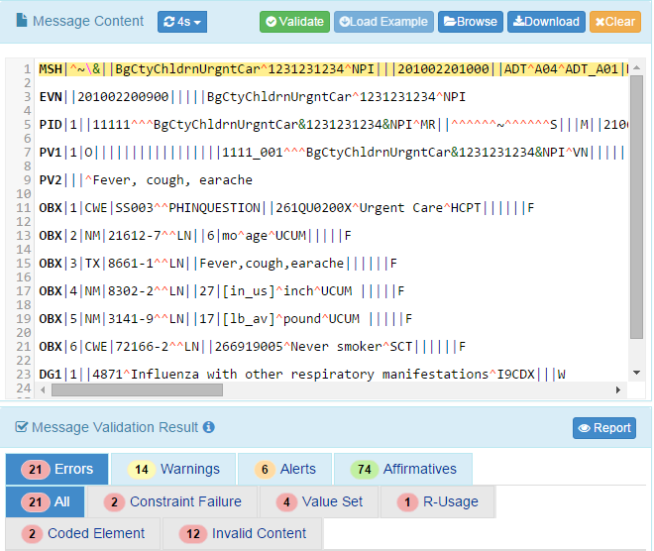
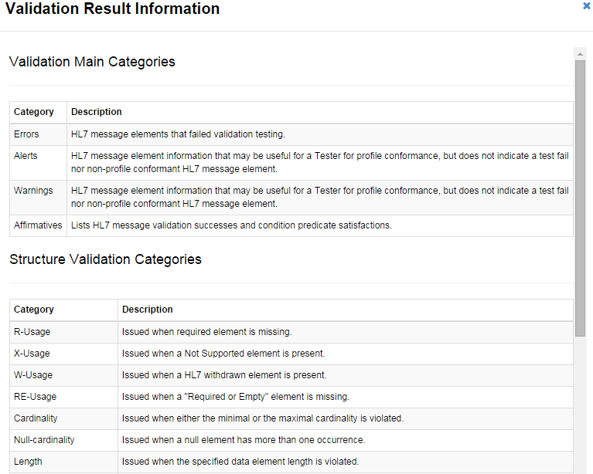
Syndromic Surveillance Context free Validation
Objectives | Informative Reference
Load and validate an HL7 message within the NIST SS Test Tool. Locate and review Errors, Warnings, Alerts and Affirmatives. Locate the ‘Information Button’ provides Validation Result Information | Performing HL7 message validation generates notifications for the Tester about the test and validation successes/failures. These are indicated as ‘Errors’, ‘Warnings’/’Alerts’, and ‘Affirmatives’.
9a
The HL7 message validation results are displayed within the ‘Message Validation Result’ field. Various testing notifications are generated for the Tester.
The types of notifications are:
‘Errors’ – HL7 message elements that failed validation testing.
‘Warnings’, and ‘Alerts’– HL7 message element information that may be useful for a Tester for profile conformance, but does not indicate a test fail nor non-profile conformant HL7 message element.
‘Affirmatives’ – Lists HL7 message validation successes and condition predicate satisfactions.
The exact HL7 message ‘Line’ and ‘Column’ location where the notification was discovered is displayed, as well as ‘Description’ for why the notification was flagged. Clicking the ‘Path’ highlights in the Message Tree and Message Content fields the HL7 message notification data element. Clicking ‘Details’ displays a popup with additional constraint/code metadata.
Clicking the ‘Report’ button presents the Tester with a consumable Message Validation Report that captures the totality of HL7 Context-free validation for the given HL7 message under test.
Notes:
Fix all images; Sheryl commented too small to read

Slide 10
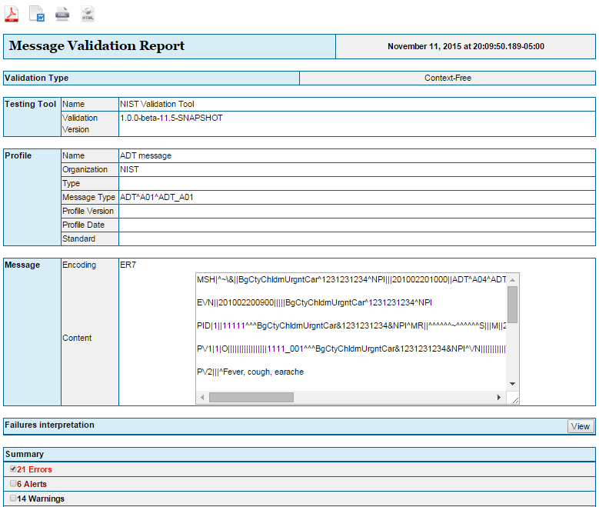
HL7 Message Validation Report
Objectives | Informative Reference
Locate the ‘Context-free’ tab on the Navigation Bar. Locate and select a profile from the NIST SS Test Tool’s available ‘Conformance Profiles’. Load and validate an HL7 message within the NIST Test Suite. Generate and review the ‘Message Validation Report’. | The ‘Message Validation Report’ gives a Tester the complete narrative for a single validation test. Multiple tests cannot be combined together within the report.
10
Select the ‘Report’ tab.
11
The ‘Message Validation Report’ presents the complete results of HL7 message validation testing in an easily consumable format.
Meta such as validation testing type, tool used, and profile used to validate against are included in the report.
A detailed summary of Errors (i.e., validation fails), Alerts, Warnings, Information elements, and Affirmatives (i.e., validation successes and condition predicate satisfactions) are also presented in the report.
Notes:
Fix all images; Sheryl commented too small to read

Slide 11
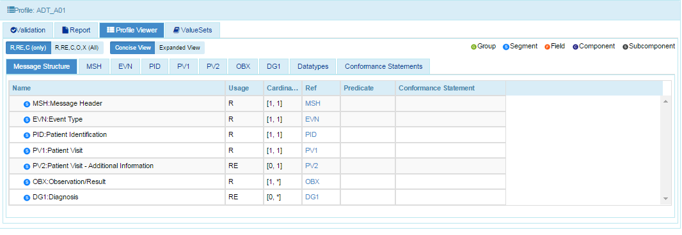
Conformance Profile Data Elements
Objectives | Informative Reference
Locate the ‘Context-free’ tab on the Navigation Bar. Locate and select a profile from the NIST SS Test Tool’s available ‘Conformance Profiles’. Load and validate an HL7 message within the NIST SS Test Tool. Generate and review the ‘Profile Viewer’. Review HL7 message data type and element requirements. | The ‘Profile Viewer’ gives a Tester the complete standard / implementation guide metadata components that is needed to perform supplemental message validation, error remediation, and troubleshooting.
12
Select the ‘Profile Viewer’ tab.
13
This display presents an interactive interface in which to view data elements and table values for a selected Conformance Profile. The ‘Message Structure’ tab displays data segments for a selected Conformance Profile. Each segment can be filtered by selecting the corresponding tab. Data types are organized based on message ‘Group’, ‘Segment’, ‘Field’, ‘Component’, and ‘Subcomponent’.
Data elements may be filtered according to Usage by selecting either:
‘R, RE, C (only)’ – Required, Required but may be empty, and Conditional; or
or ‘R, RE, C, O, X (All)’ – Required, Required but may be empty, Conditional, Optional, and Not supported.
‘Usage', 'Cardinality’, ‘Data Type’, ‘Length’ ‘Reference’, Predicate’, and ‘Conformance Statement’ fields are also represented for each data element.
Notes:
Fix all images; Sheryl commented too small to read

Slide 12
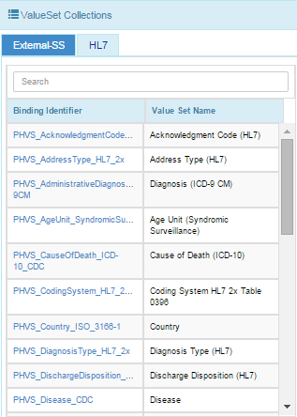
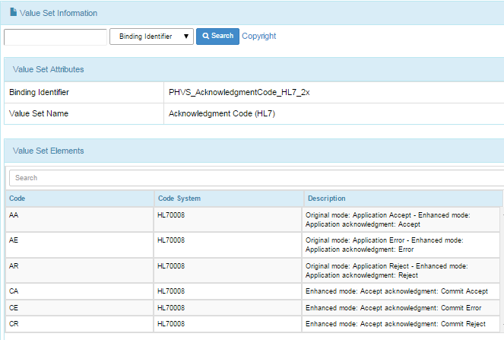
View Conformance Profile Vocabulary
Objectives | Informative Reference
Locate the ‘Context-free’ tab on the Navigation Bar . Locate and select a profile from the NIST SS Test Tool‘s available ‘Conformance Profiles’. Load and validate an HL7 message within the NIST SS Test Tool. Generate and review the ‘Message Validation Report’. Review HL7 message data type and element requirements. Browse HL7 message Value Sets requirements. | The ‘Value Sets’ tab provides the Tester a reference repository for HL7 message and standard / implementation guide driven Value Sets requirements.
14
Select the ‘Value Sets’ tab.
15
This display presents a functional way to browse Conformance Profile Value Sets requirements.
The search feature includes the capability to search based on ‘Binding Identifier’, ‘Value Set Code’, ‘Value Set Name’, and ‘Description’.
.
Notes:
Fix all images; Sheryl commented too small to read

Slide 13
Syndromic Surveillance Context-based
Test Scenario Walk Through Tool Demonstration

Slide 14
Syndromic Context-based Testing Work Flow (Step by Step)
1) Select Test Case
Open Syndromic Surveillance Validation tool using link: http://hl7v2-ss-r2-testing.nist.gov/ Click on Context-based Validation tab. Click on arrows to expand the first Test Scenario. Expand the Test Cases and select a Test Case. Test Case displays.
2) Select Test Step and review Test Story
Select Step 1 of Test Case. Test Story displays.
3) Review Test Data Specification and Message Content
Click on Test Data Specification tab. Full tab is selected by default. To view a specific section, click on a tab. Relevant real-world clinical data is displayed. Click on Message Content tab. Location specifies the location of a data element within the message. Name of data element is provided. Exact value of the data element for the selected Test Step is provided. The categorization indicates if the data is fixed or can be changed.
4) Create test message
Using the EHR technology, create the Syndromic Surveillance test message with the test data provided for the selected Test Step (step 3).

Slide 15
Syndromic Context-based Testing Work Flow (Step by Step – cont’d)
5) Load Test Step and import test message
Click on Select button to load the Test Step. Validation page displays. Click on Browse Message button. Message Uploader Dialog window displays. Click on Select Message button. Open test message file created in step 4 to upload it.
6) Validate test message and review message validation errors
Uploaded test message displays. If message fails validation, errors will display in Message Validation Result section of page. Click on location link to highlight the data element causing the error within the Message Tree and Content. Description explains why error occurred. Format or table of data element may be provided. Line number and column of errors are provided. Click on page numbers to view additional pages of errors. Location link displays the location of the data element.
7) Generate Validation Report
Click on Report Details icon to generate a report. Message Validation Report may be downloaded as a PDF, XML, Word doc, HTML file. Message Validation Report may be printed.

Slide 16
Syndromic Context-based Testing Work Flow (Step by Step – cont’d)
8) Look up valid data element values and tables
Click on Profile Viewer tab. Click on a tab to select the conformance profile. Select R, RE, C (Only) to view only required, required but may be empty and conditional elements. Select R, RE, C, O, X (All) to view all data elements, including optional and not supported elements. Click on a tab to filter data elements by segment. Locate data element using element name from the location link. Make a note of the table ID. Click on Vocabulary tab. Locate and select table ID. Valid values are listed. Click on Context-based Validation tab to return to message.
9) Repeat steps 2-8 for each additional Test Step of Test Case
Select next Test Step of the Test Case and repeat steps 2-8.

Slide 17

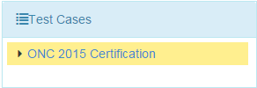
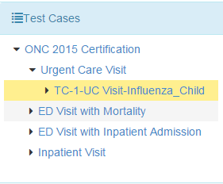
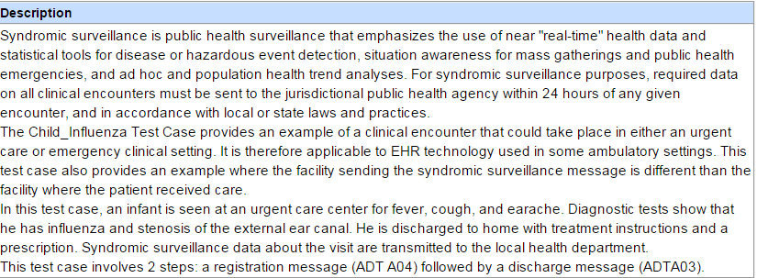
HL7 Context-based Test Case Selection
Objectives | Informative Reference
Locate the ‘Context-based’ tab on the Navigation Bar. Locate ‘Test Cases’ under the Test Selection Tab. Access additional information on standard / implementation guide documentation and profile linkages. | The ‘Context-based’ tab contains the target HL7 Context-based testing elements and associated HL7 message validation engine.
1
Select ‘Context-based’ from the Navigation Bar.
2
Select a ‘Test Case’ below the highlighted ‘Test Selection’ tab.
3a
The ‘Test Story’ provides a Description of what is being tested. Comments, Precondition, Post condition, Test objectives and Evaluation Criteria, are also include as part of the Test Story.
3
Arrow down ‘Administration Group’ to choose a test case. The Test Story will be displayed on the right.
After choosing a test case, arrow down to select a test step.
6
Notes:
Images associated with 2, 3, and 4 too small to read

Slide 18
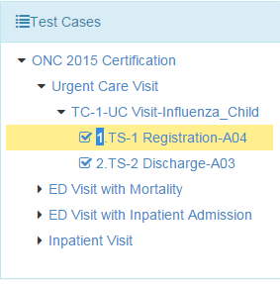
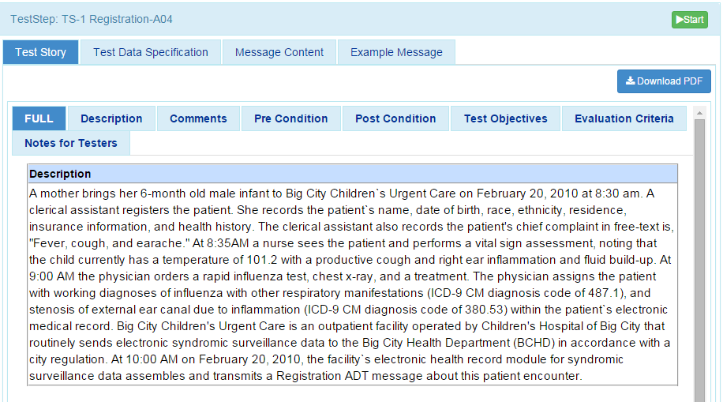
Context-based Message Validation
Objectives | Informative Reference
Locate the ‘Context-based’ tab on the Navigation Bar. Locate Test Steps, that supports the test cases. Obtain ‘Test Story(s)’ descriptions imitating real world scenarios. | Each Test Step provides unique real world test scenarios that identifies with real world situations. The descriptions are provides under the Test Story tab. Additional Information on the Test Case and/or Test Step is also located under the ‘Test Story’ tab.
4
Highlight a test step.
7
Click ‘Start’.
5
The highlighted 'Test Step’ will display a Description of the Test Story. The ‘Test Story’ provides a use case scenario.
6
Scroll down to review additional information provided under the ‘Test Story’ tab. Additional information includes: Comments, PreCondition, PostCondition, Test Objectives, Evaluation Criteria, and Notes to Tester.

Slide 19
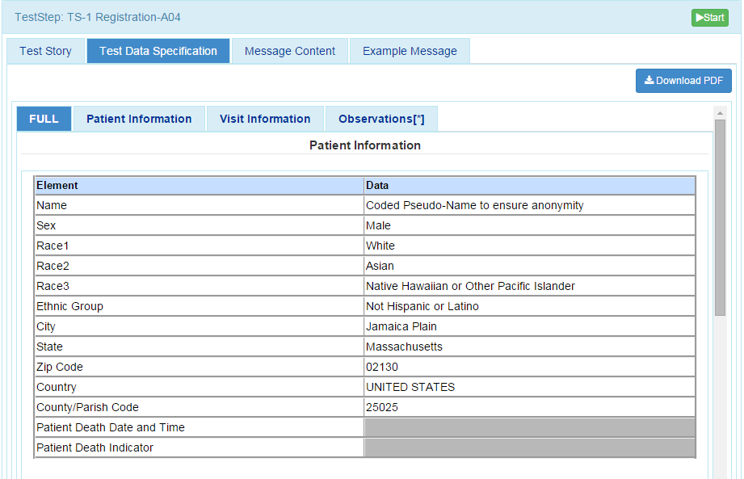
Context-based Message Validation (continued…)
Objectives | Informative Reference
Locate the ‘Context-based’ tab on the Navigation Bar. Locate ‘Test Data Specification’ tab. Obtain relevant real world clinical data. Download Test Data Specification information. | This page specifies the data that are entered (automatically/manually) into the EHR and included in the message that is created and submitted from the EHR to the Immunization validation tool. The tester shall identify an existing patient record in the EHR or shall create a patient record in the EHR using the data in the Data Sheet associated with the Test Case.
8
Click on ‘Test Data Specification’ tab.
9
11
‘Full’ tab is selected by default. To view a specific section, click on a tab.
Test Data Specification may be downloaded as a PDF file.
10
Relevant real-world clinical data is displayed.

Slide 20
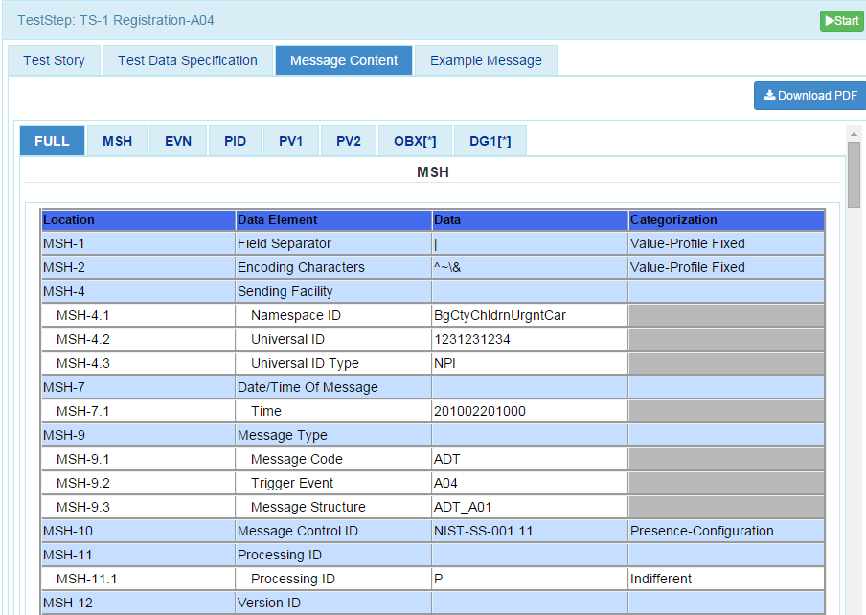
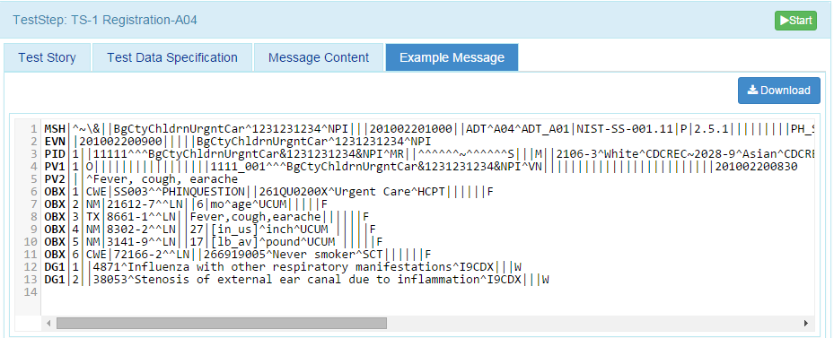
Context-based Message Validation (continued…)
Objectives | Informative Reference
Locate the ‘Context-based’ tab on the Navigation Bar. Locate the ‘Message Content’, that supports the test cases. Using the EHR technology, create the Immunization test message with the test data provided for the selected Test Step. | This page provides details of the message segment, as well as an example of a valid instance of each data element. Message Content or an Example Message can be downloaded as a PDFfile.
12
17
Click on ‘Message Content’ tab.
‘Message Content’ can be downloaded
13
‘Location’ specifies the location of a data element within the message.
16
‘Categorization’ indicates if the data is fixed or can be changed. It also indicates the level of validation that will be assessed on the data.
14
Exact value of the data element for the selected Test Step is provided. (i.e. NPI)
19
Click ‘Start’
15
Name of ‘Data Element’ is provided.
18
An example of the HL7 Message is displayed by clicking on ‘Example Message’.
20
An ‘Example Message’ can be downloaded

Slide 21
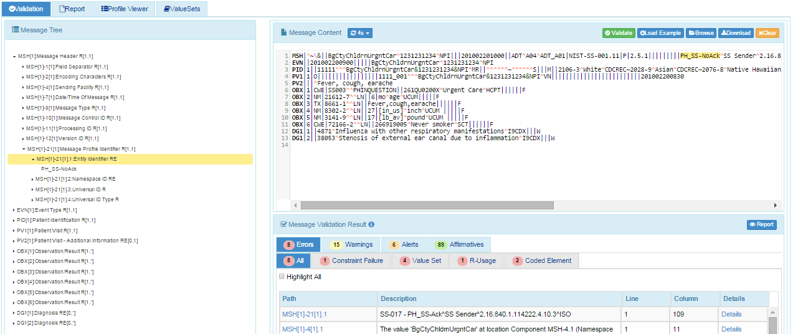
Context-based Message Validation (continued…)
Objectives | Informative Reference
‘Load Example’ HL7 message. ‘Validate’ HL7 Message content. View Validation results. Generate ‘Message Validation Report’. | This page validates any Immunization message created by the EHR. It is disassociated from a test script, test case, or specific content (test data).
21
Click the Browse button to load an existing HL7 message from the testers local machine, or click ‘Load Example’ to populate sample HL7 message. Your message will load in the field provided.
20
Selecting ‘Start’ will send you to the ‘Test Execution’ tab.
22
26
Click ‘Validate’.
Click the Path link to highlight the location of the Error in the Message Tree and the Message Content
25
Click on ‘Report ‘icon to display Message Validation Report.
23
Total number of errors displays.
24
Validation results appear.

Slide 22
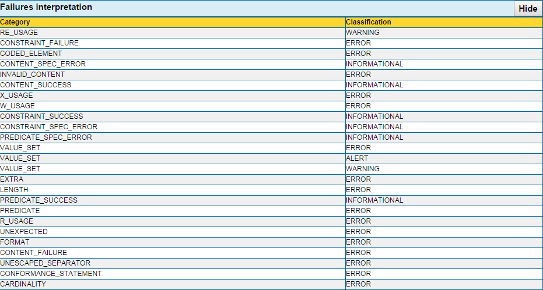
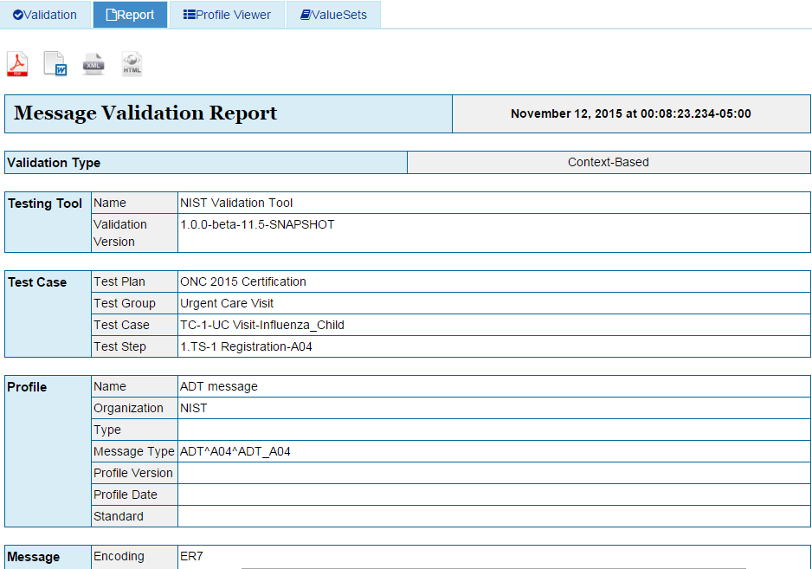
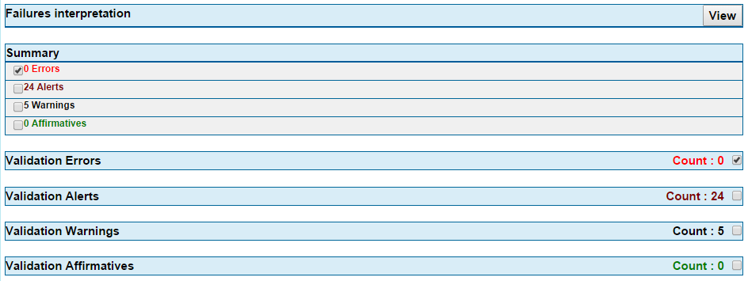
Context-based Testing Message Validation Report
26
After clicking ‘Report’, the Message Validation Report will appear.
27
‘Message Validation Report’ may be downloaded as a PDF, XML, Word doc, HTML file.
28
Clicking on the ‘View’ button will show Failure interpretation. This provides classification for types of errors.
29
Note See slides 11-12 for ‘Profile Viewer’ and ‘Value Sets’.

